Slide 1
IoT Architectures
Dr. Bhawana Rudra
NITK

Slide 2
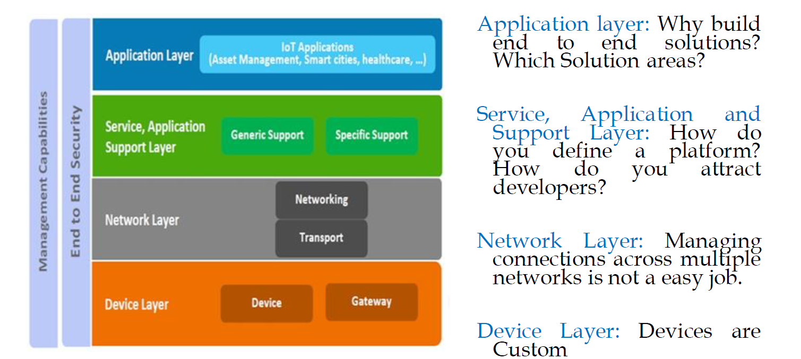

Slide 3
Application layer:
It provides Interface for users to interact with necessary modules to control and monitor various aspects of the IoT System.
Application allow user to visualize, and analyze the system status at present stage of action, sometimes prediction of futuristic prospects

Slide 4
Service, Application support layer
A IoT system serves various types of functions such as services for
Device Modeling
Device Control
Data Publishing
Data Analytics
Data Discovery

Slide 5
Communication
Communication block performs the communication between devices and remote sensors
IoT communication protocol generally work in DataLink Layer, Network Layer, Transport Layer and Application layer

Slide 6
Devices
IoT system is based on devices that provide sensing, actuation, control and monitoring activities
IoT devices can be of various types such as wearable sensors, smart watches, LED lights, automobiles and Industrial machines

Slide 7
Security
Secure IoT System provides
Authentication: verifying identity of a person or device
Authorization: Determining user privileges or access level
Privacy: safe environment to secure data and communication
Message Integrity: Validity of a transmitted message
Data Security: protective digital privacy measures that are applied to prevent unauthorized access to computers, databases and websites

Slide 8
Management capabilities
Management block provides different functions to govern an IoT system to seek the underlying governance of IoT System.
Managing different layers functionality

Slide 9
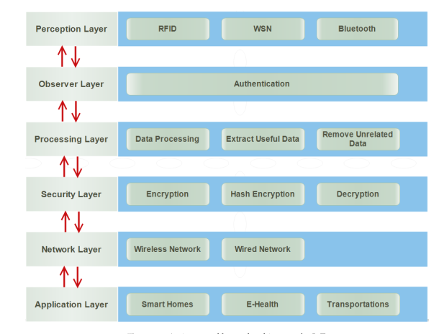
6-Layered Architecture

Slide 10
PERCEPTION LAYER
It is also known as a sensor layer or physical layer.
It identiﬁes objects in order to gather information.
For this purpose, different types of sensors are attached to the objects such Radio Frequency Identiﬁcation (RFID) tags, barcode, Bluetooth, wireless sensors, LTE, etc.
A sensor is chosen according to the needs of users and objects where it is attached.
It sends collected information to the observer layer to check the authentication of these sensors and devices.

Slide 11
Observer Layer
The observer layer is also known as a monitor layer.
The perception layer sends information to the observer layer.
It checks information about whether it is protected from intruders and viruses or not.
If there is any attack, it does not pass information to the next layer for further processing.
It only passes that information that is protected from intruders and viruses.
Furthermore, it also checks authentication of the objects.
There are many ways to prove the identity such as authentication.
Protocols used for authentication : -
PAP
CHAP
EAP

Slide 12
Processing Layer
It collects information from the observer layer. It trusts that the information provided by the observer layer is protected from every type of attack.
This layer is designed to eliminate unnecessary information. It stores, analyzes and processes a huge amount of information that comes from the observer layer.
It uses various technologies to extract useful information such as databases, cloud computing and data processing modules.
The reason of removing unnecessary information is to save the network from heavy traffic.
It also saves storage devices so that they cannot cross their limits.

Slide 13
Security Layer
There are many proposed architectures of IoT, but they do not have a layer regarding security.
It is designed to make the architecture of IoT secure. There are many attacks on the network layer trying to get information from the users.
Therefore, it makes secure information before sending to the network layer.
It receives information from the processing layer. It performs encryption by converting all information collected from the processing layer into an unknown form, called cipher text.
The process of encryption is performed by using keys. It sends the encrypted information to the network so that it could not be understood by anyone other than the authentic users.
It also sends a key to the receiver to convert the cipher text into the original text. Thus, this layer protects the information of users from the attackers and risks existing on the network layer.
There are many ways to encrypt and decrypt information such as the Advanced Encryption System (AES) and Data Encryption System (DES).

Slide 14
Network Layer:
The network layer is also known as a transmission layer. The work of the Network layer is to connect all things together and give access to the sharing of information to other connected things.
It receives this information from the security layer in the form of ciphertext.
The reason for receiving information in the ciphertext is to protect the information from attackers and risks.
The information can be transmitted through any of the medium i.e wireless media or wired.
The medium is selected based on the needs of users and also communication technologies.
Therefore, it is highly sensitive to attacks from the side of attackers.
It has prominent security issues regarding the integrity and authentication of information that is being transported in the network.

Slide 15
Application Layer
Application layer is one of the last layers of the 6 layered architecture. It is responsible for data formatting and presentation.
It is also responsible for delivery of numerous applications to different users.
It deﬁnes several applications in which IoT can be used, such as smart home, smart transport, smart cities, smart health, animals and agriculture.
It has a responsibility for providing the application speciﬁc service to the users.
The service is chosen according to the information that is collected by the sensors from objects.
Application layer deﬁnes all applications that use the IoT technology or in which IoT has deployed.
The services may be varying for each application because services depend on the information that is collected by sensors. There are many issues in the application layer in which security is the key issue.
In particular, when IoT is used in order to make a smart home, it introduces many threats and vulnerabilities from the inside and outside.
To implement strong security in an IoT based smart home, one of the main issues is that the devices used in smart homes have weak computational power and a low amount of storage such as ZigBee

Slide 16
Thank You

